Slide 1
RETAIL SALES
Data Visualization Analysis
Univariate • Bivariate • Multivariate Analysis of 100,000 Orders
Data Visualization Project

Slide 2
About the Dataset
100,000
18
6
3
Total Orders
Columns / Features
Product Categories
Customer Segments
What each order record contains
Customer: age, gender, city, state, segment
Product: category, sub-category, price, quantity
Order: discount %, final price, payment, shipping, delivery days, return status
Roadmap
1
Univariate Analysis
2
Bivariate Analysis
3
Multivariate Analysis
Retail Sales Analysis

Slide 3
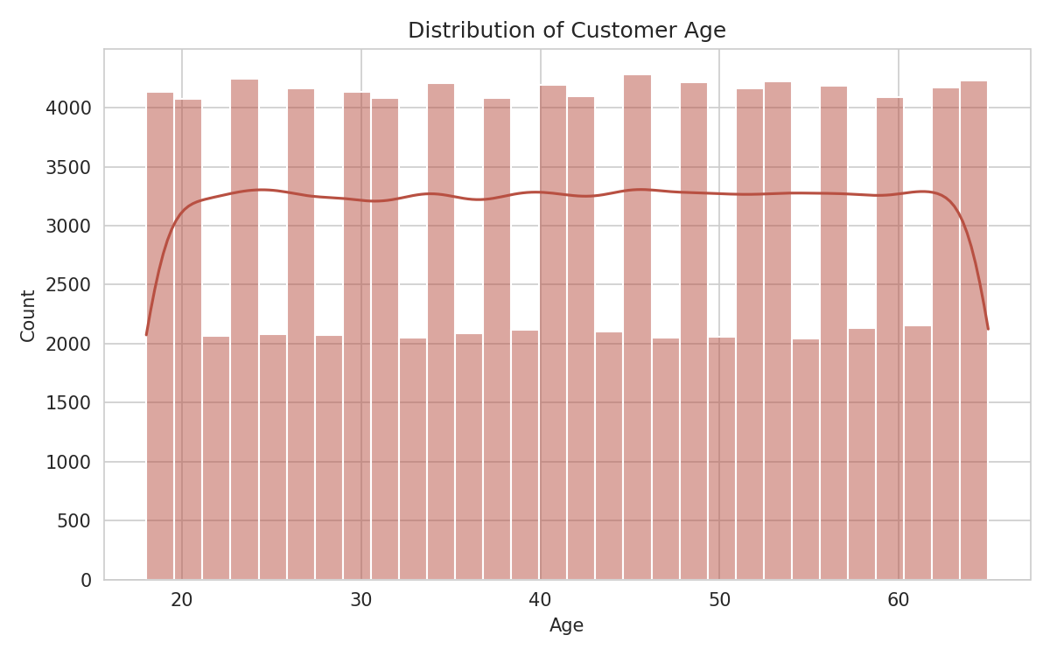
1
UNIVARIATE ANALYSIS
Customer Age Distribution
Ages range from 18 to 65, roughly evenly spread across the range.
No single age group dominates — bar heights stay close to ~4,000-4,200 orders throughout.
This flat, uniform shape (unlike a typical bell curve) suggests the customer base is synthetically balanced across ages rather than skewed toward any generation.
Retail Sales Analysis | 03

Slide 4
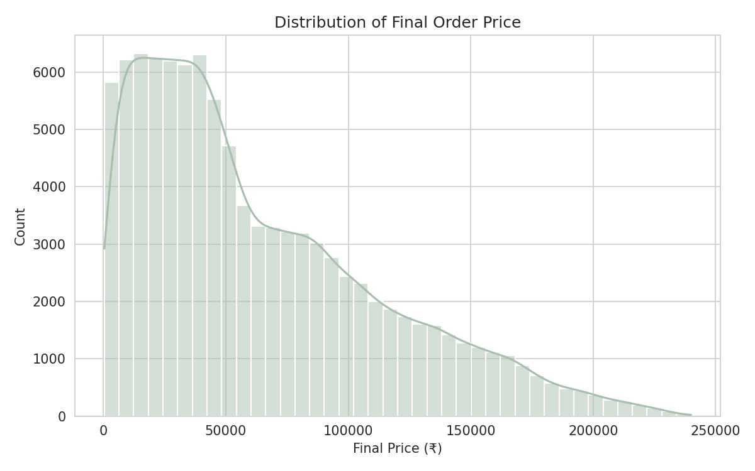
1
UNIVARIATE ANALYSIS
Final Order Price Distribution
Order values (final_price) range from under ₹500 to nearly ₹240,000.
The distribution is right-skewed — most orders cluster at lower values with a long tail of high-value orders.
Mean order value is about ₹64,166, noticeably higher than the median (~₹49,752), confirming the skew.
Retail Sales Analysis | 04

Slide 5
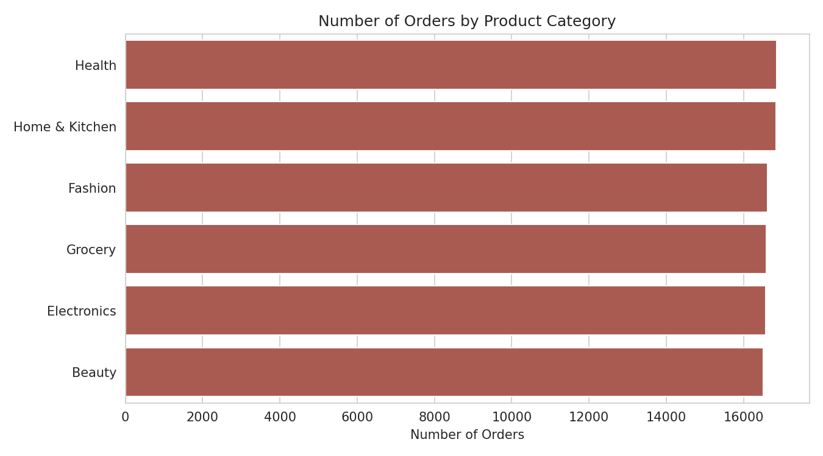
1
UNIVARIATE ANALYSIS
Orders by Product Category
All six categories (Health, Home & Kitchen, Fashion, Grocery, Electronics, Beauty) receive a near-identical share of orders.
Counts range narrowly from ~16,513 (Beauty) to ~16,858 (Health) — about a 2% spread.
No category dominates demand; catalog exposure appears evenly engineered across the store.
Retail Sales Analysis | 05

Slide 6
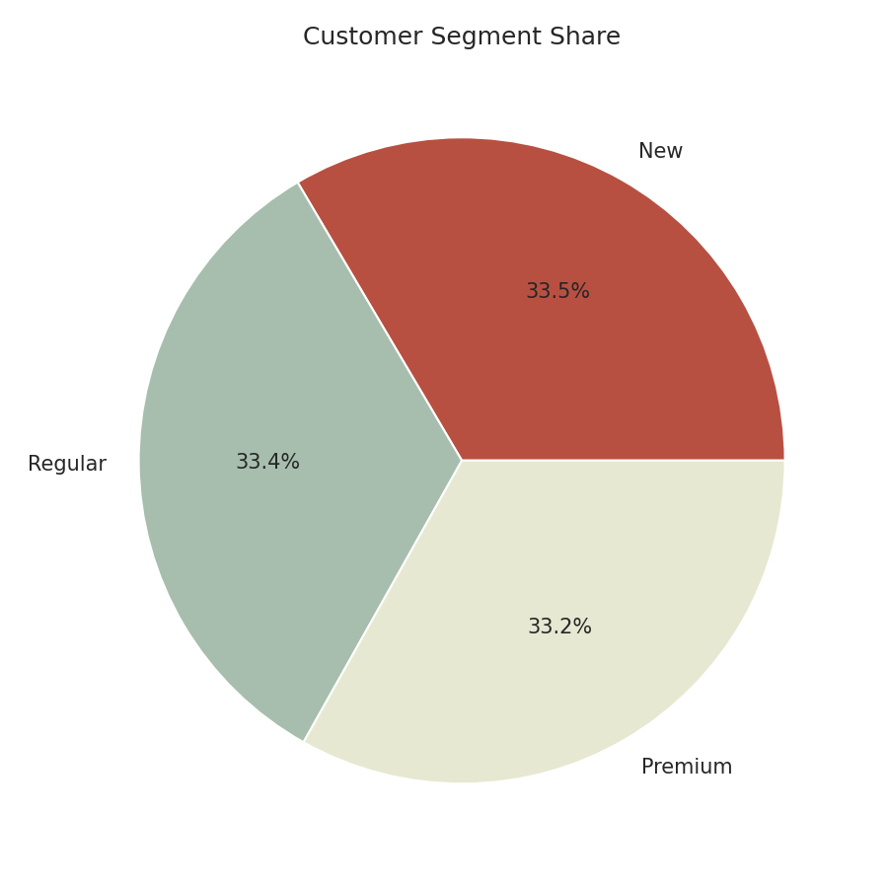
1
UNIVARIATE ANALYSIS
Customer Segment Share
Customers split almost exactly into thirds: New (33.5%), Regular (33.4%), Premium (33.2%).
There's no dominant segment — the customer base is deliberately balanced, not naturally skewed toward one loyalty tier.
This even split is a useful baseline before checking whether segments behave differently in spending (bivariate analysis, next).
Retail Sales Analysis | 06

Slide 7
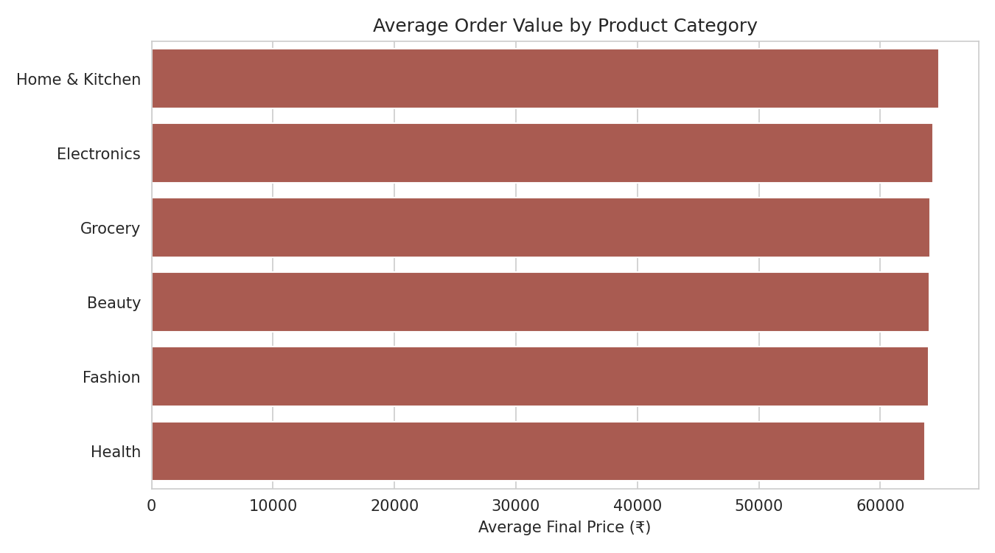
2
BIVARIATE ANALYSIS
Average Order Value by Category
Average final price is nearly flat across categories — from ₹63,687 (Health) to ₹64,840 (Home & Kitchen).
The gap between the highest and lowest category average is under 2%.
Unlike many real retail datasets, product category alone doesn't drive order value here — other factors (price, quantity) matter more.
Retail Sales Analysis | 07

Slide 8
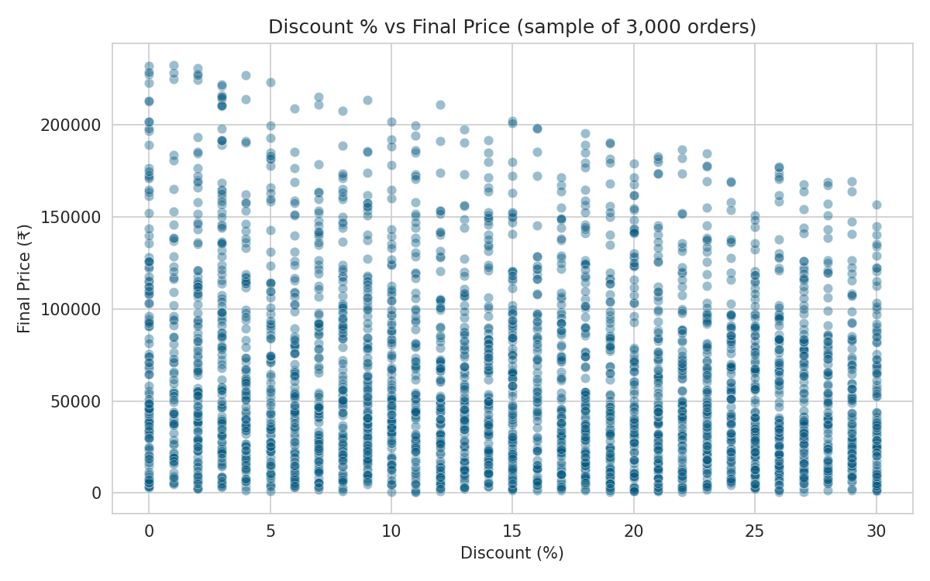
2
BIVARIATE ANALYSIS
Discount % vs Final Price
The scatter plot shows a wide, cloud-like spread — no tight linear pattern.
Correlation coefficient is only -0.14, a weak negative relationship: higher discounts modestly pull final price down, as expected.
The wide spread confirms product price and quantity (not discount) are the real drivers of what a customer ultimately pays.
Retail Sales Analysis | 08

Slide 9
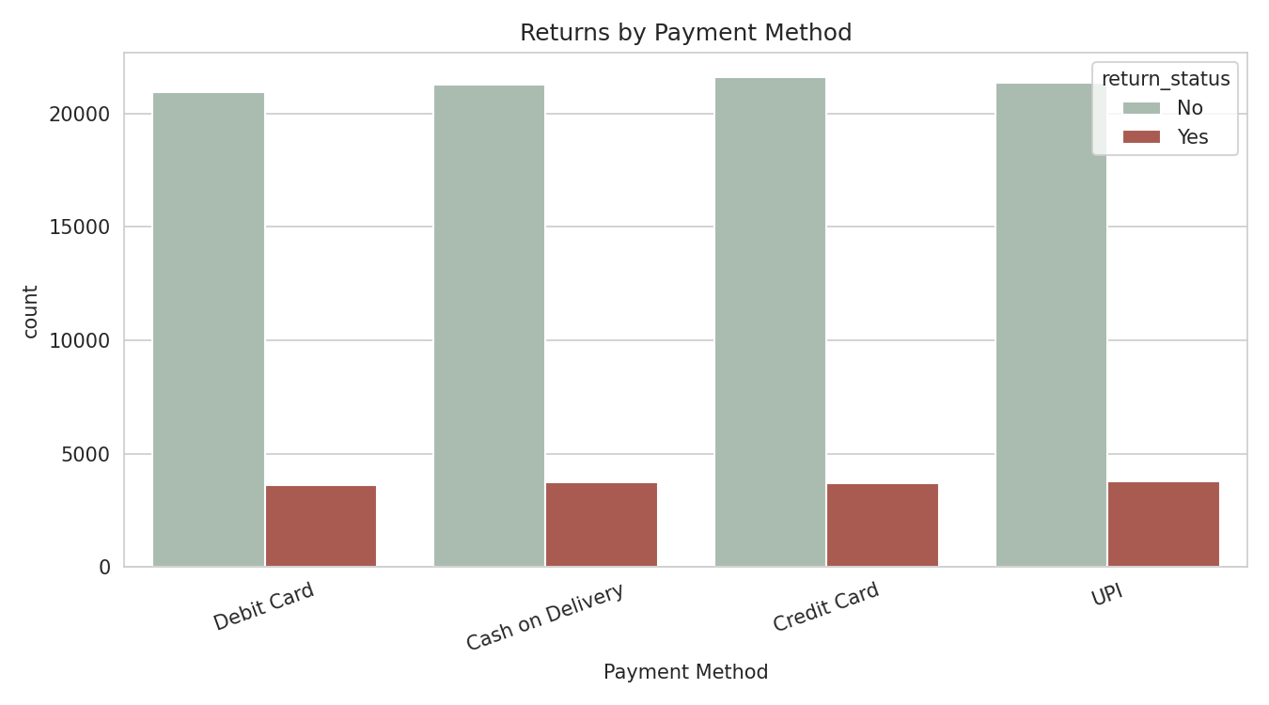
2
BIVARIATE ANALYSIS
Returns by Payment Method
Overall return rate across all orders is 14.8%.
Return rate barely varies by payment method: UPI (15.0%), Cash on Delivery (14.9%), Debit Card (14.7%), Credit Card (14.6%).
Payment method shows no meaningful influence on whether an order gets returned.
Retail Sales Analysis | 09

Slide 10
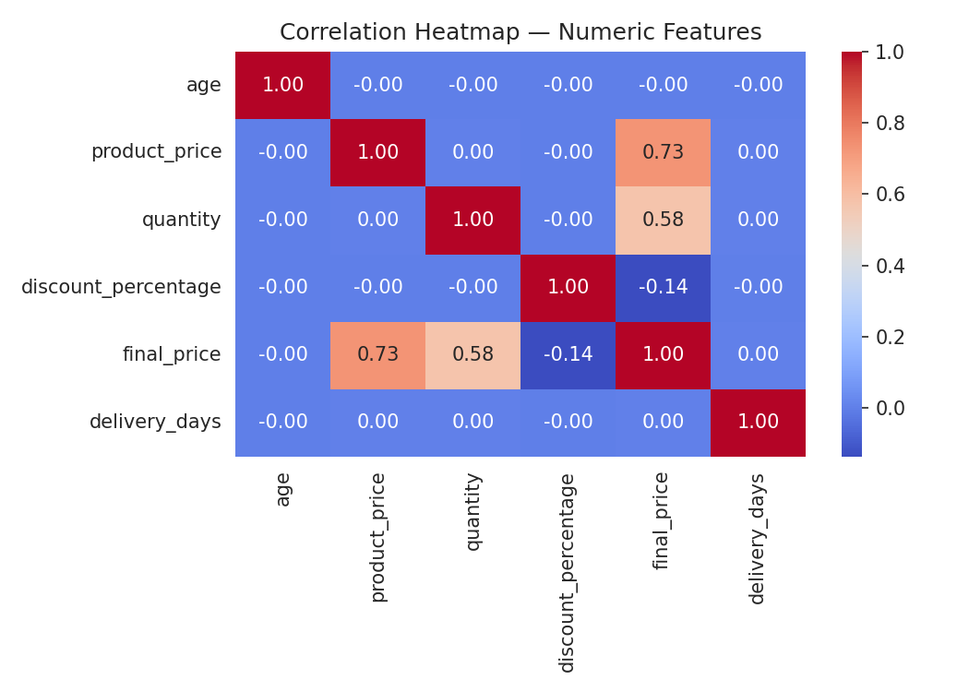
3
MULTIVARIATE ANALYSIS
Correlation Heatmap — Numeric Features
final_price correlates strongly with product_price (0.73) and quantity (0.58) — expected, since final price is derived from both.
final_price has a weak negative correlation with discount_percentage (-0.14).
age and delivery_days show virtually no correlation (~0.00) with any other numeric field — they behave independently in this dataset.
Retail Sales Analysis | 10

Slide 11
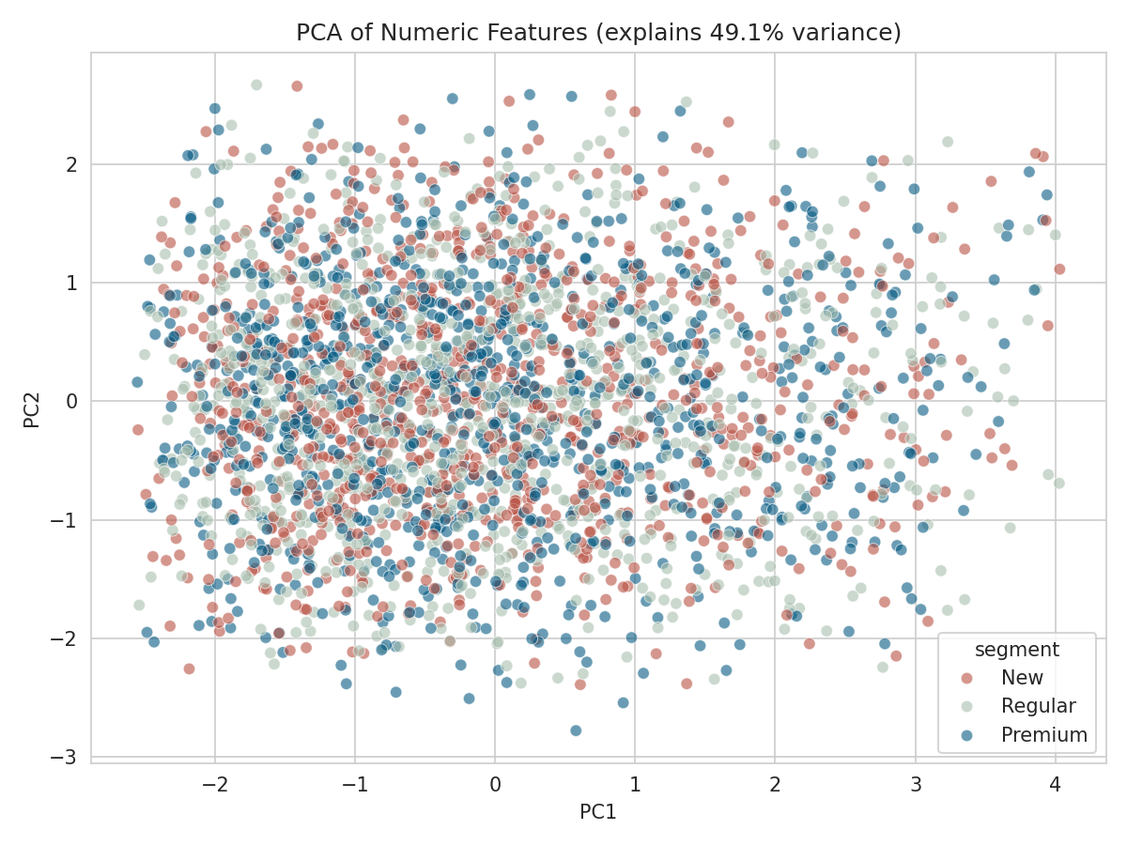
3
MULTIVARIATE ANALYSIS
PCA — Reducing 6 Features to 2 Dimensions
Principal Component Analysis compresses age, price, quantity, discount, final price, and delivery days into 2 components.
Together, PC1 and PC2 explain about 49% of total variance (32.4% + 16.8%) — a moderate summary, not a full picture.
Points colored by customer segment (New / Regular / Premium) overlap heavily — segments are not visually separable from these numeric features alone.
Retail Sales Analysis | 11

Slide 12
Key Takeaways
Balanced Data
Price Drives Price
Ages, categories, and segments are all evenly distributed — this dataset is engineered, not organically skewed.
final_price is explained mainly by product_price and quantity, not by discount or customer traits.
Weak Behavioral Signals
PCA Confirms It
Payment method, category, and age show almost no relationship with returns or spend.
Even combining all numeric features, customer segments don't separate — segment likely depends on non-numeric factors.
Thank you

Slide 13
THANK YOU
Prepared & Presented by
Suresh Kumar
NextHikes IT Solutions

